Slide 1
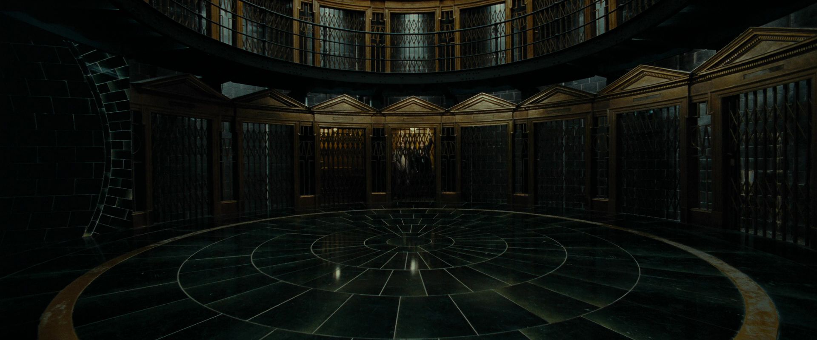
The Magic Elevator
Max Funck & Shawn Polson

Slide 2

Transition Slide

Slide 3


Slide 4
Softvare

Slide 5
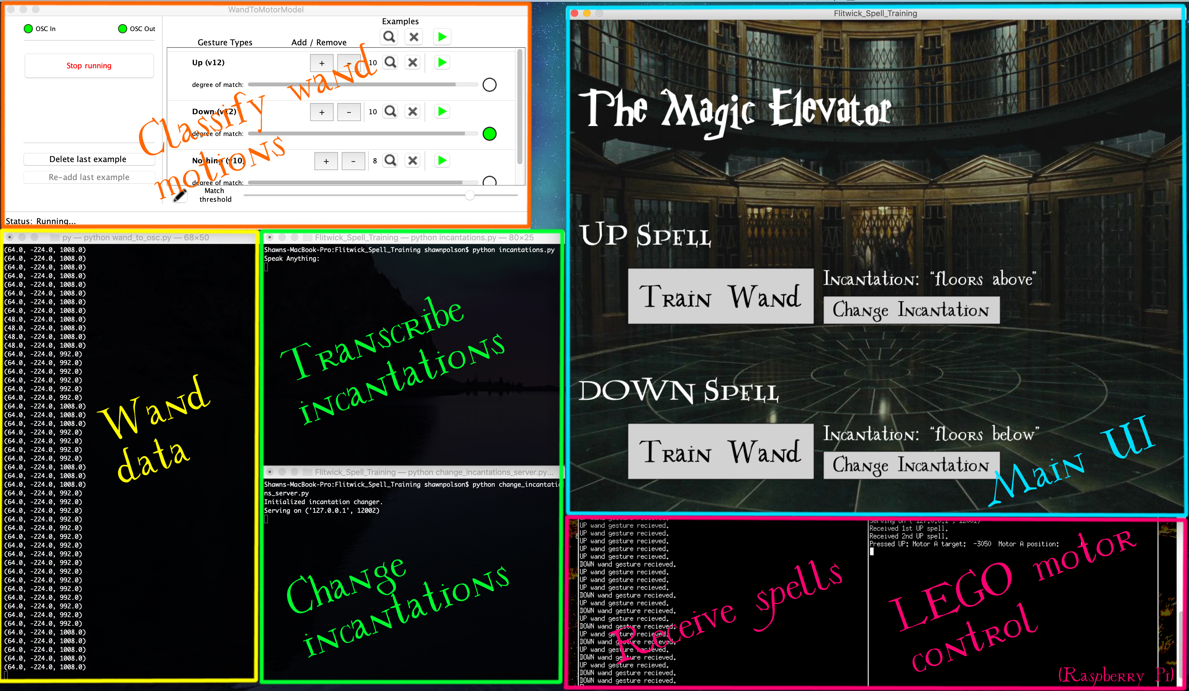

Slide 6
Hardvare

Slide 7
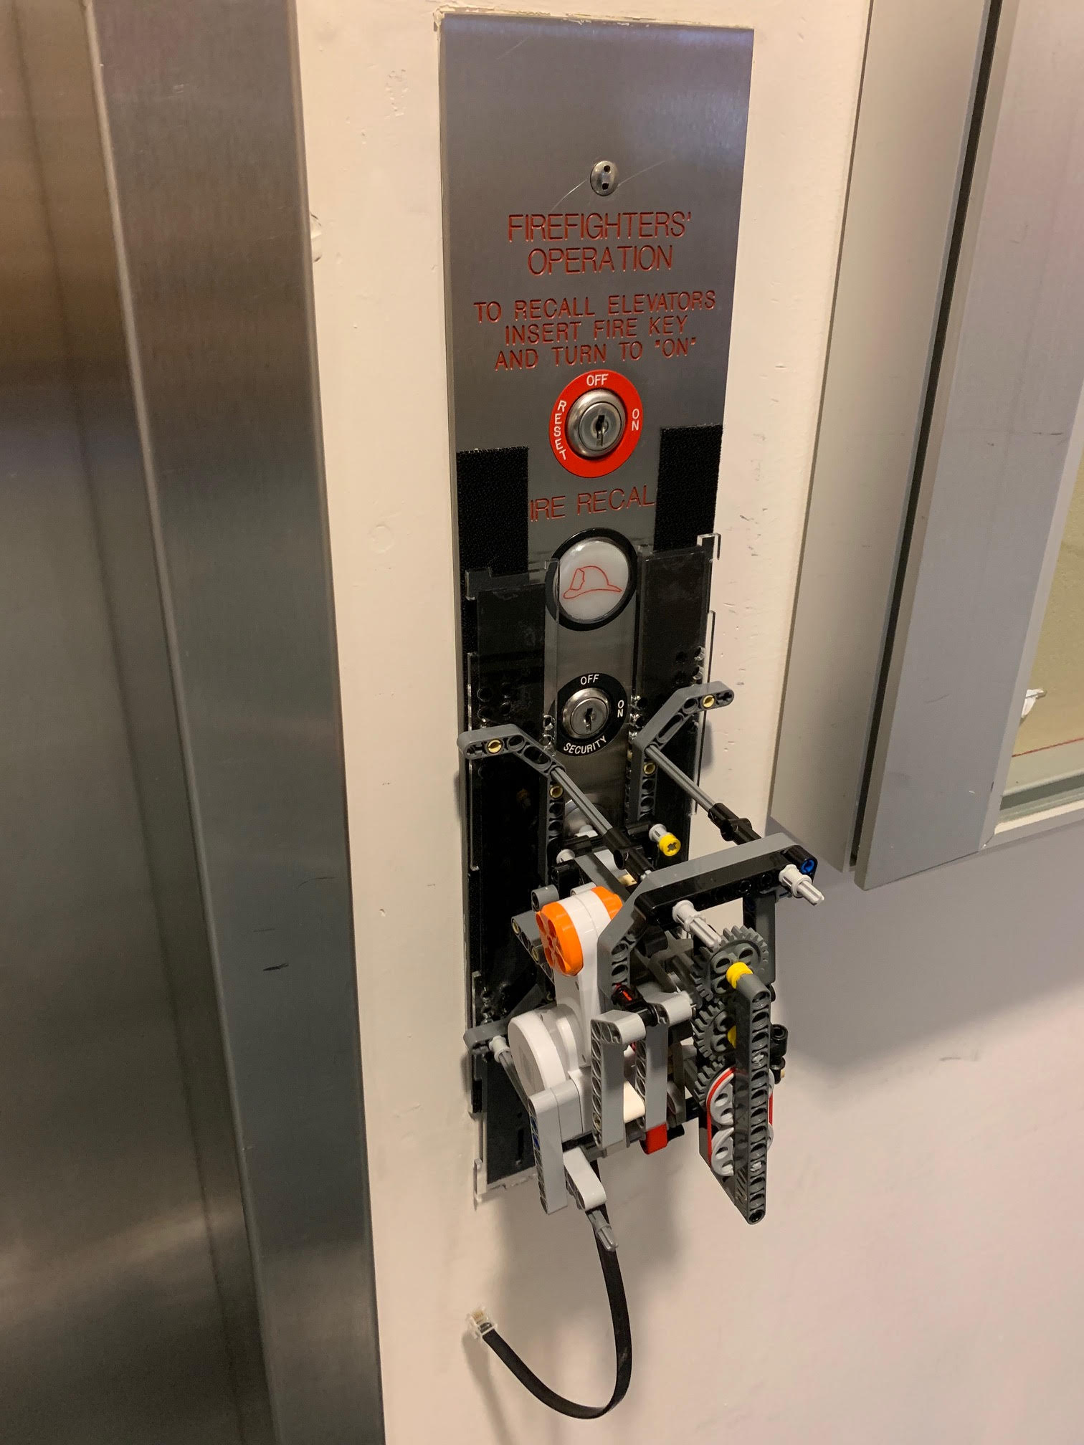

Slide 8
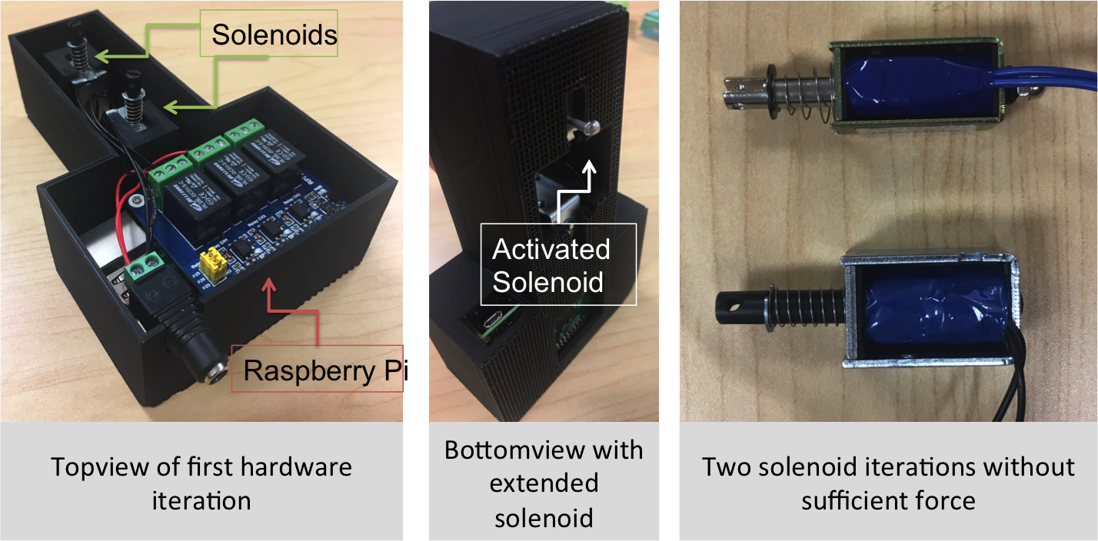

Slide 9
The System

Slide 10
